Slide 1
Stock Market Analysis Project
Domain : Finance
By : Arnav Deore

Slide 2
Project Overview
01
02
03
04
05
06
Data collection and Analysis
Analysing insights using KPI’s
Used Excel, Tableau, Power BI and SQL
Created different Dashboards on Stock market analysis
Market opportunity
Financial & metrics

Slide 3

Objective of the Project
The Primary objective of this dataset is to provide insights into the Stock Market performance of the selected major companies.
We aim to identify patterns, trends and anomalies in the stocks behaviour over time to make informed decisions regarding the Stock purchases.

Slide 4
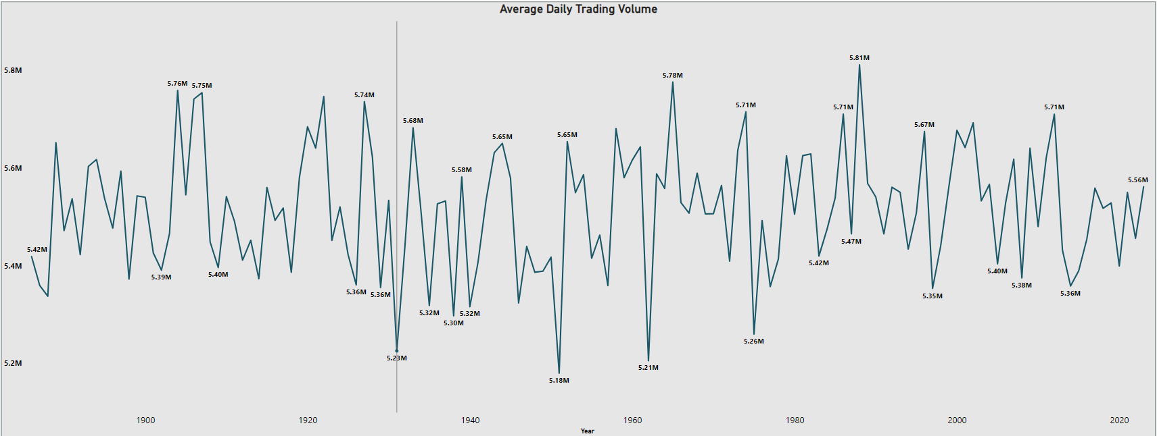
KPI – 1 Average Daily Trading Volume
The Year 1988 stands out with the highest average volume of 5811608.926
This year experienced the highest average trading volume, likely due to the market’s recovery phase. This period saw increased investor activity as confidence was being restored and opportunities were plentiful in a rebounding market.

Slide 5
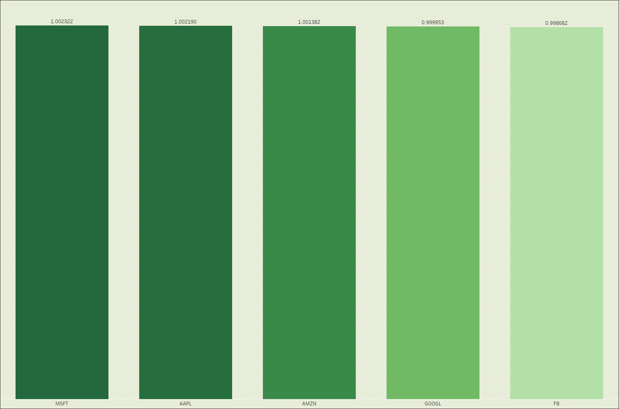
KPI – 2 Most Volatile Stocks
Beta is a measure of stocks volatility in a relation to the market as a whole.
A beta of 1 indicates that stocks price tends to move in tandem with the market. A beta greater than 1 suggests the stock is more volatile than the market, while a beta less than 1 implies it’s less volatile.
Considering the highest beta among the listed stocks, MSFT could be considered the most volatile in this context.

Slide 6
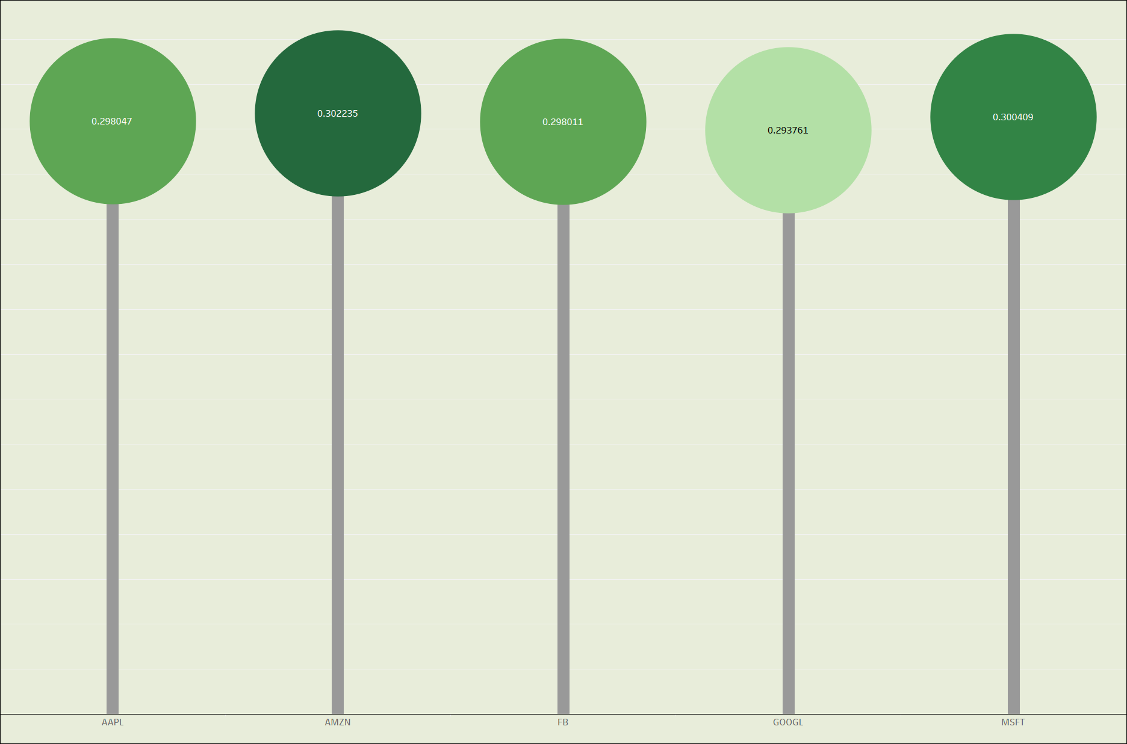
KPI – 3 Stocks with Highest and Lowest Dividend
Highest Dividend Stock:
The stock with the highest average dividend amount is AMZN with an average dividend amount of 0.302235 indicating it provides the most significant returns to its shareholders in terms of dividends.
Lowest Dividend Stock:
The stock with the lowest average dividend amount is GOOGL with an average dividend amount of 0.293761 suggesting it distributes the least to its shareholders among the companies listed.

Slide 7
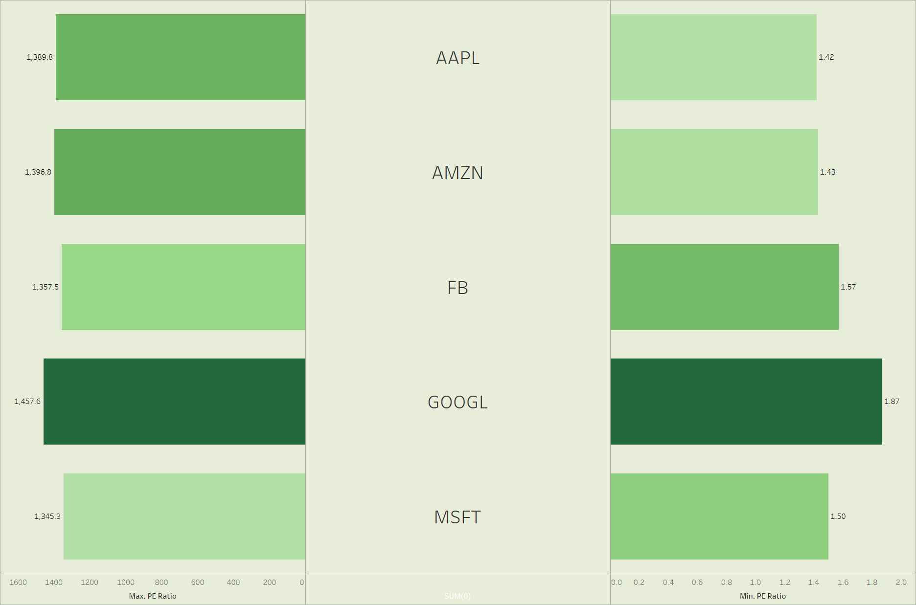
KPI - 4 Highest & Lowest P/E Ratios
Highest P/E Ratio:
Google has the highest maximum P/E ratio of 1457.55
A P/E ratio of this magnitude suggests extremely high investor expectations for future earnings growth.
Lowest P/E Ratio:
Apple has the lowest minimum P/E ratio of 1.42
Investors might have lower expectations for future growth possibly due to market conditions, competition or other factors affecting the company’s earnings.

Slide 8
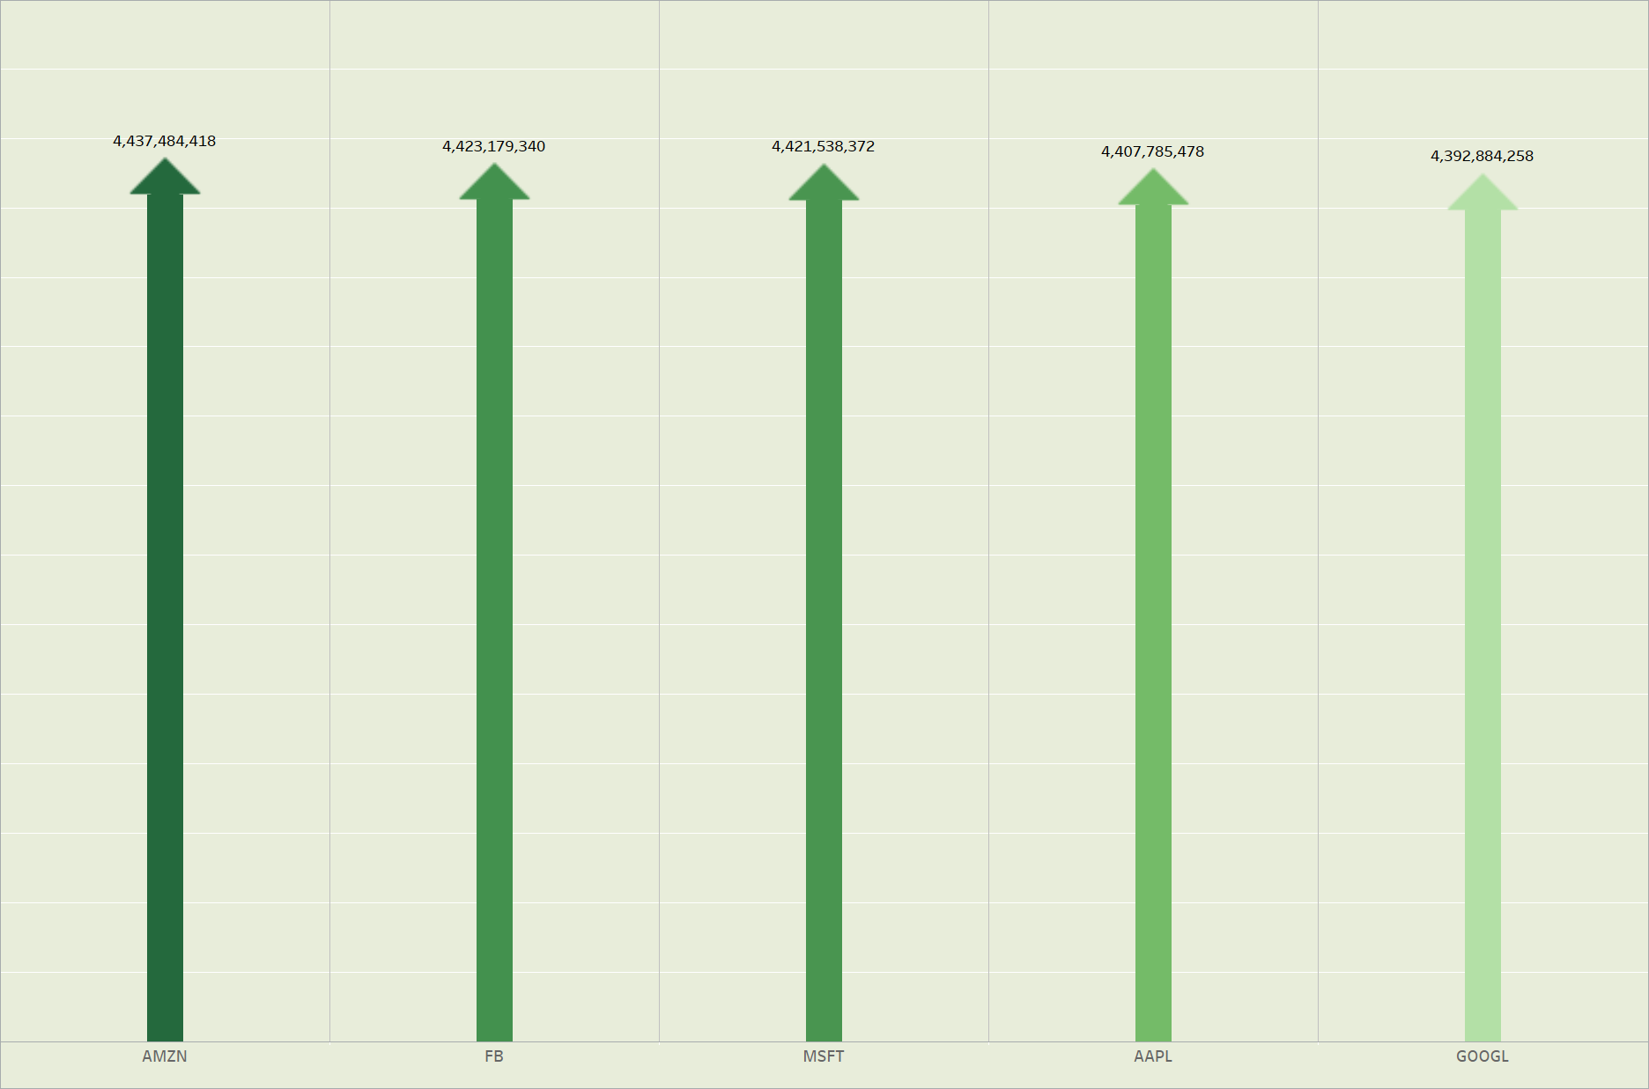
KPI – 5 Highest Market Capitalization
Amazon has the highest market cap of 4,437,484,418
As the highest market capital stock among these 5 tech giants, Amazon’s valuation reflects investor confidence in its ability to generate significant earnings and maintain a competitive edge in various industries.

Slide 9
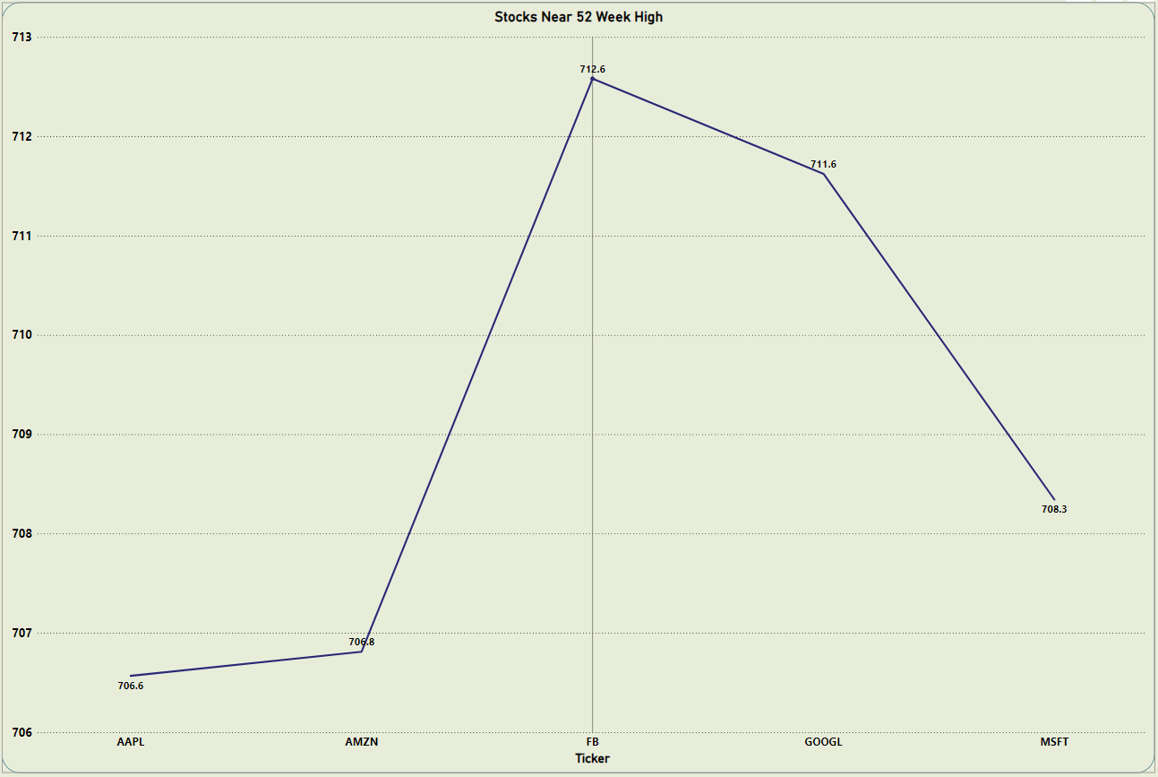
KPI – 6 Stocks near 52 week High
Apple and Amazon are the stocks closest to their 52-week highs might be seen as more stable or potentially less volatile.
A stock near its 52 week high typically reflects positive market sentiment and investor confidence in the company’s future performance. This can be influenced by strong earnings reports, product launches or favourable industry trends.

Slide 10
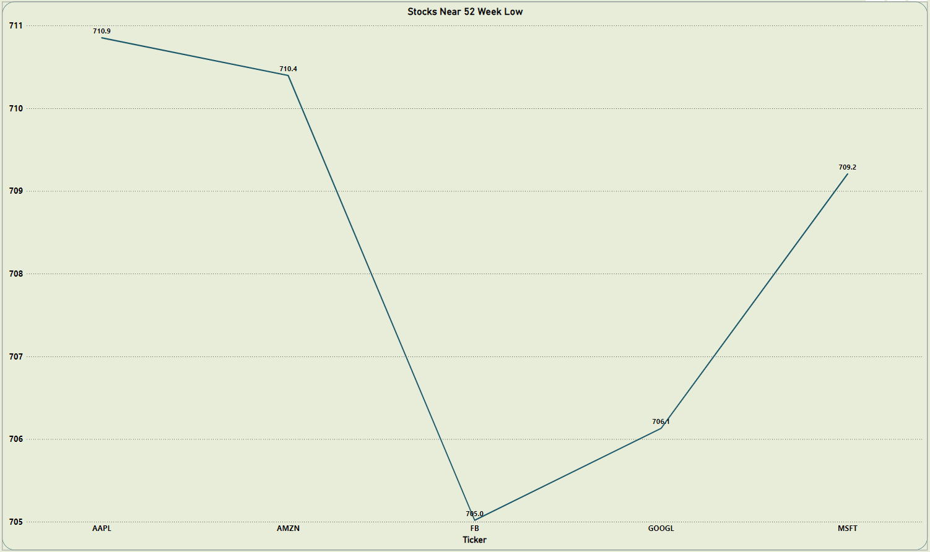
KPI – 7 Stocks near 52 week Low
Facebook has the lowest average difference from their 52 week low of 705.02 , indicating it is closer to its lowest point in the past year.
A stock near its 52 week low might indicate ongoing challenges, declining performance or negative market sentiment. It’s crucial
to identify the reasons behind the low prices to make informed decisions.

Slide 11
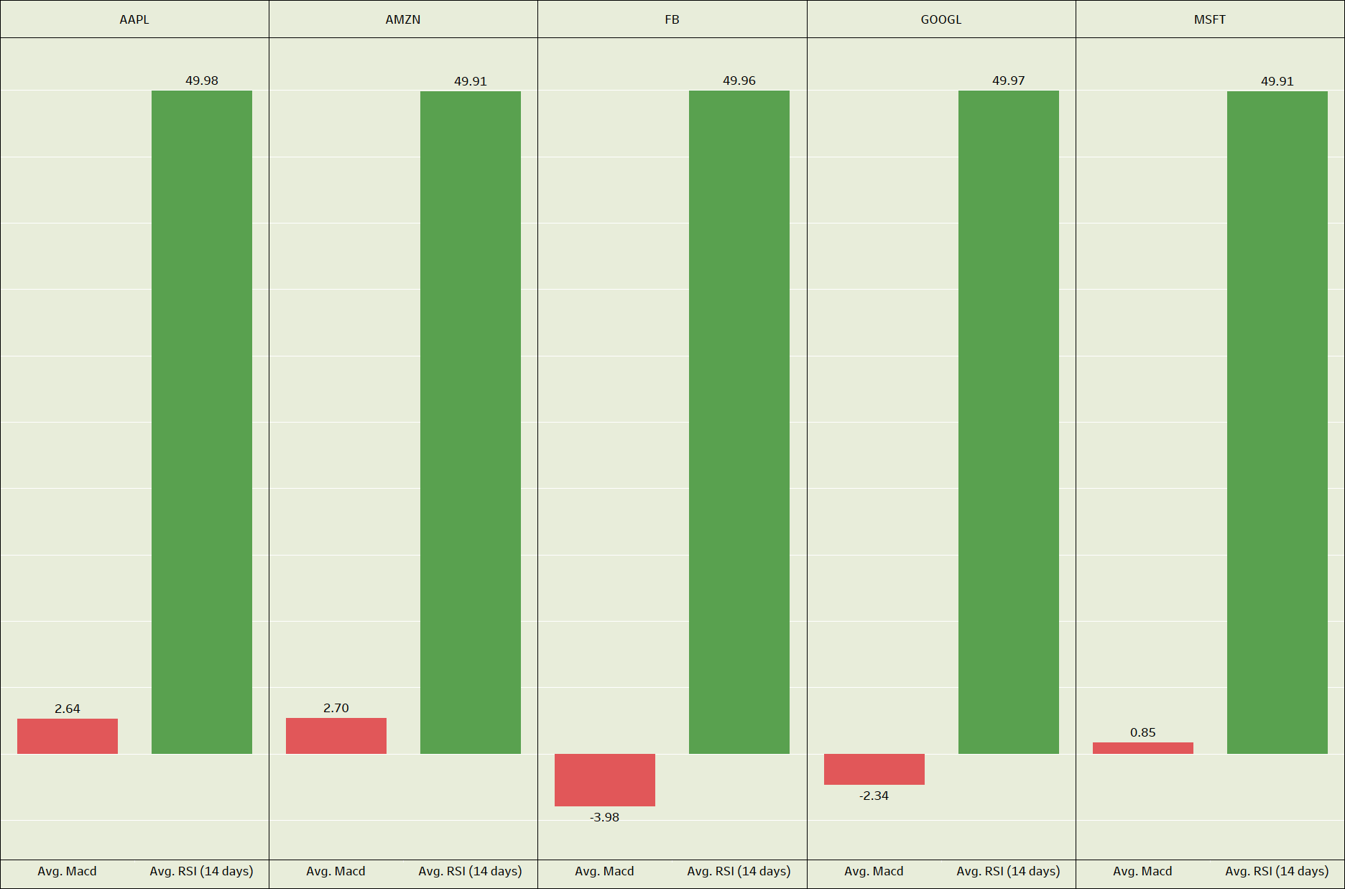
KPI – 8 Stocks with Strong buying and Strong selling Signals
RSI: Stocks with RSI values significantly above 50 might be considered to have a strong buying signal like APPL, AMZN, FB, GOOGL and MSFT all have RSI values close to 50 suggesting neutrality, but not necessarily a strong buy signal based on RSI alone.
MACD: Stocks with positive MACD values like APPL, AMZN and MSFT, might be considered to have a strong buy signal based on MACD
: Stocks with negative MACD values like FB and GOOGL might be considered to have a strong selling signal based on MACD.

Slide 12
Conclusion
Best stock to Invest in:
Considering the balance of volatility, valuation and income potential, MICROSOFT appears to be a strong choice due to its high dividend and moderate valuation despite its higher volatility
Worst Stock to Invest in:
GOOGL might be considered less attractive due to its lower dividend amount and relatively higher P/E ratio.

Slide 13
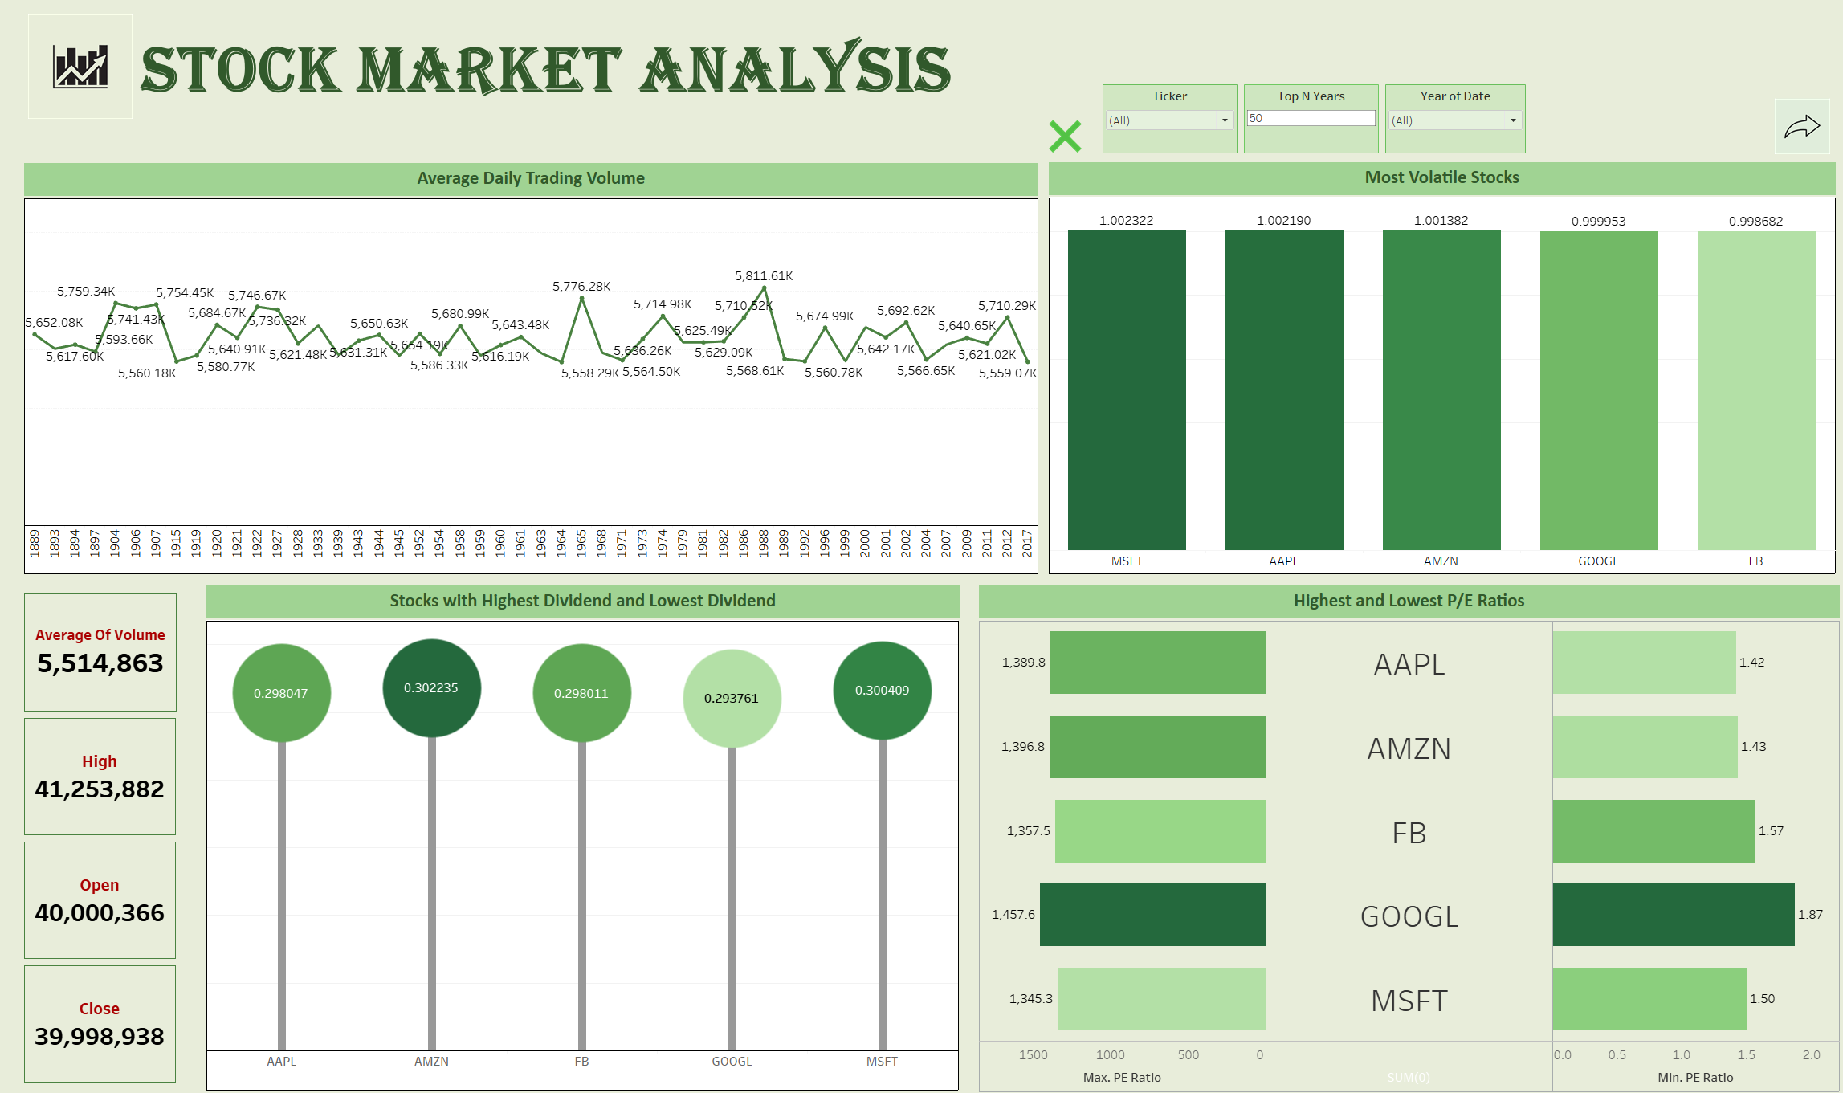
Tableau Dashboard

Slide 14
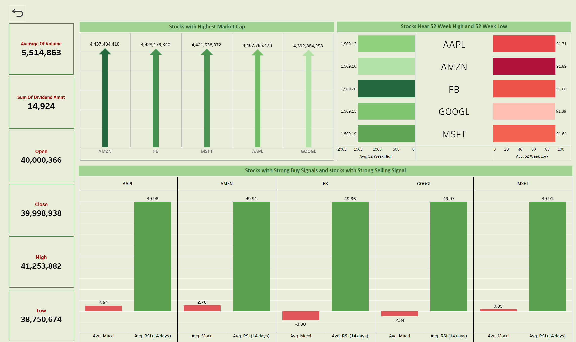
Page - 2

Slide 15
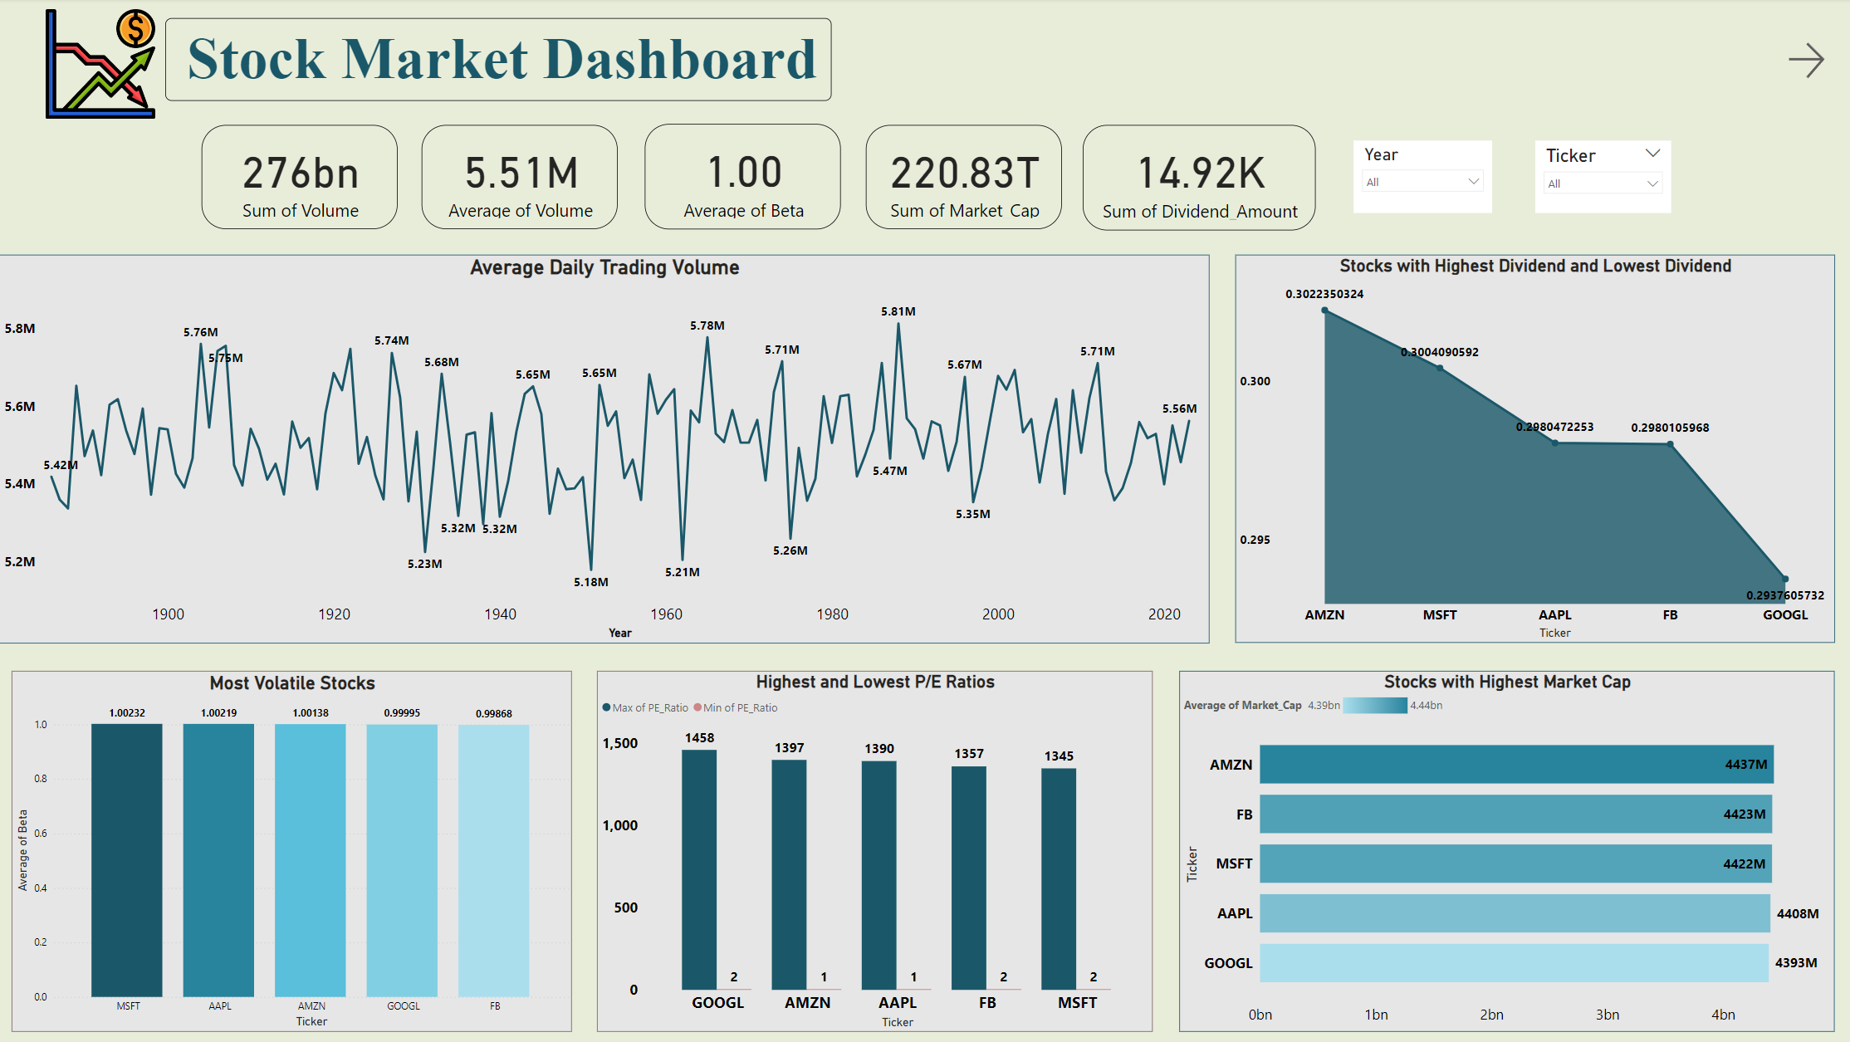
Power BI Dashboard

Slide 16
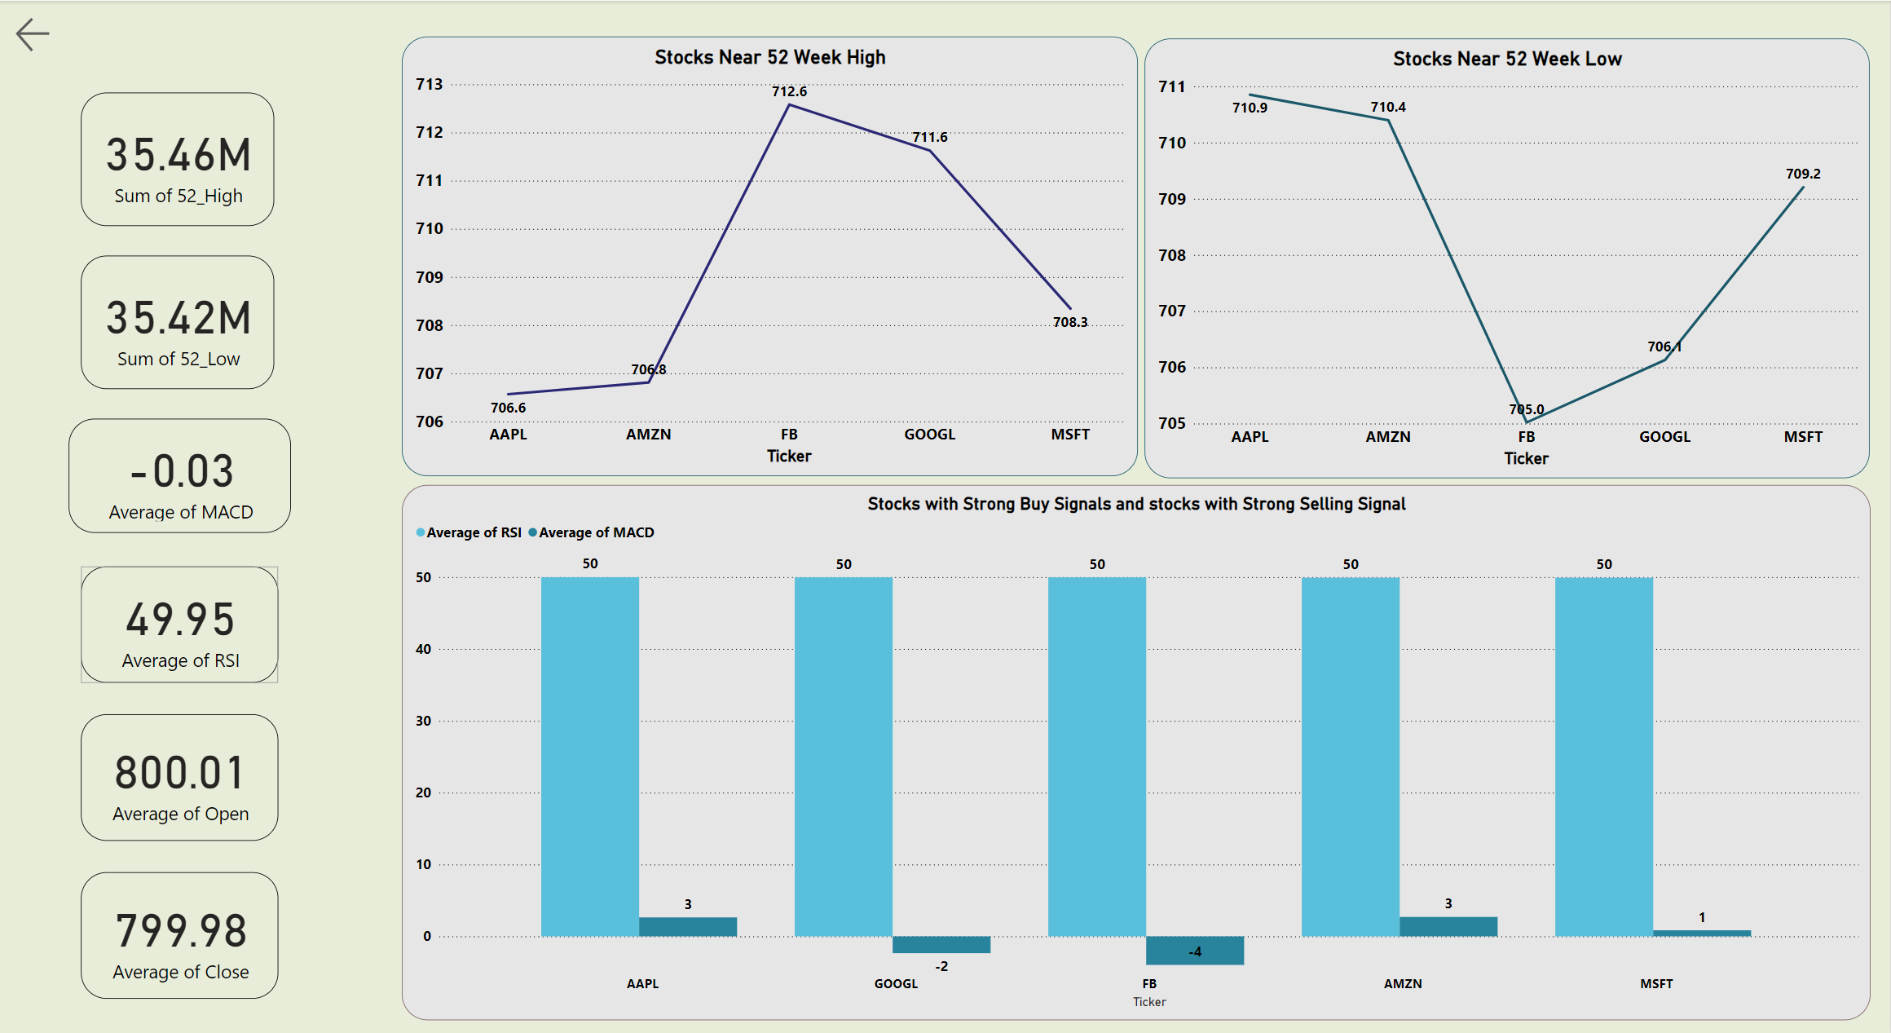
Page - 2

Slide 17
Thanks!

